Slide 1
PreViser-What’s New Quarter 3, 2020

Slide 2
New Training Resources & Webinars
New PreViser Support Site includes
Download PowerPoint training for dental provider
Easy to navigate support
Create a support ticket
Access to all user guides and scientific articles
Trainer Resources
Provides the dental insurance rep with the tools needed for success in training dental offices
Ability to download and customize PowerPoint for your practice or oral wellness program

Slide 3
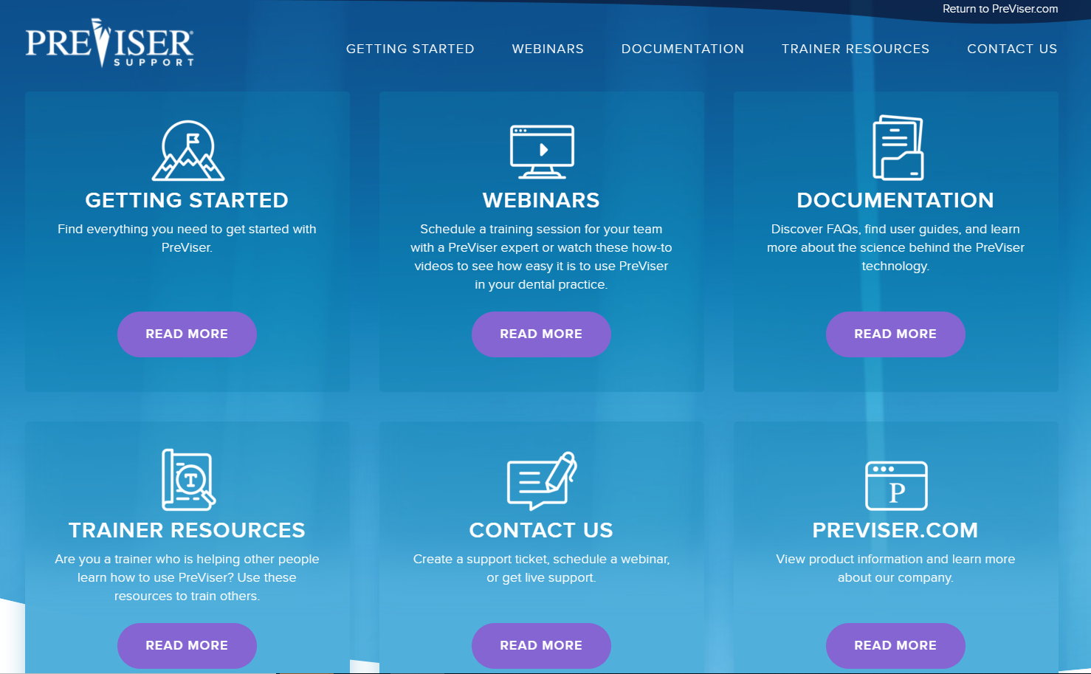
PreViser Developments
New PreViser Support Site– Sept 2020

Slide 4
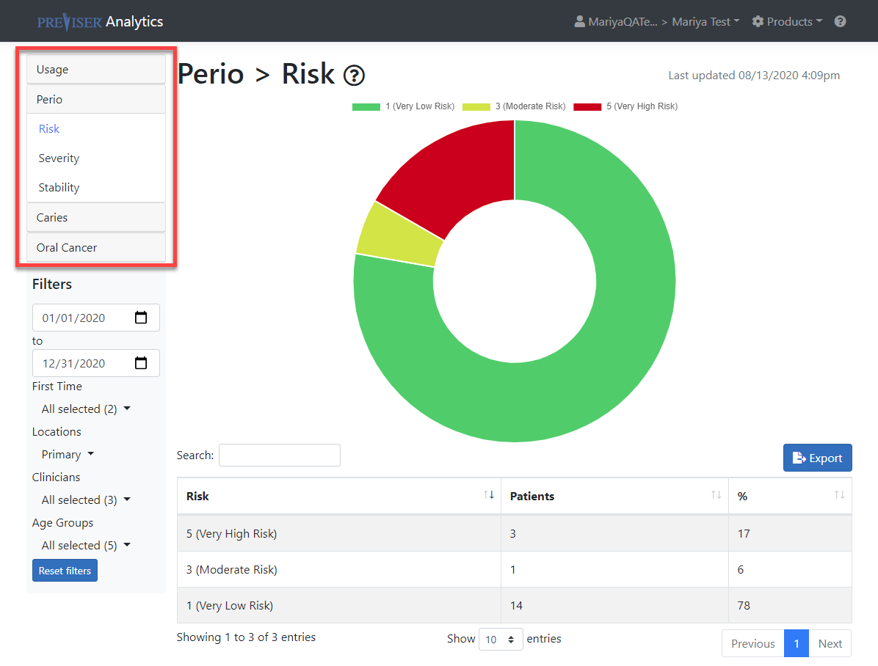
Enterprise Analytics – Assessment Types
Improve Reporting/Analytical foundation to support Dental Office
Now includes:
New look
Assessment type
Risk
Severity
Stability
Needs

Slide 5
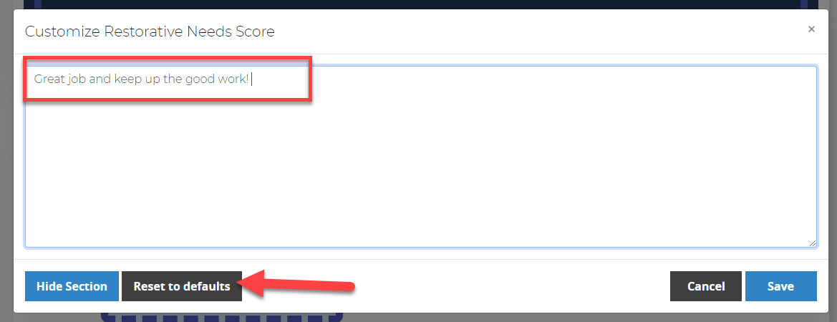
Enterprise Customization of Reports – Back to Defaults
After dental providers have customized reports, they will have the option of reverting back to the practice defaults.

