Slide 1
Advanced Topics

Slide 2
Bulk Import of Patients

Slide 3
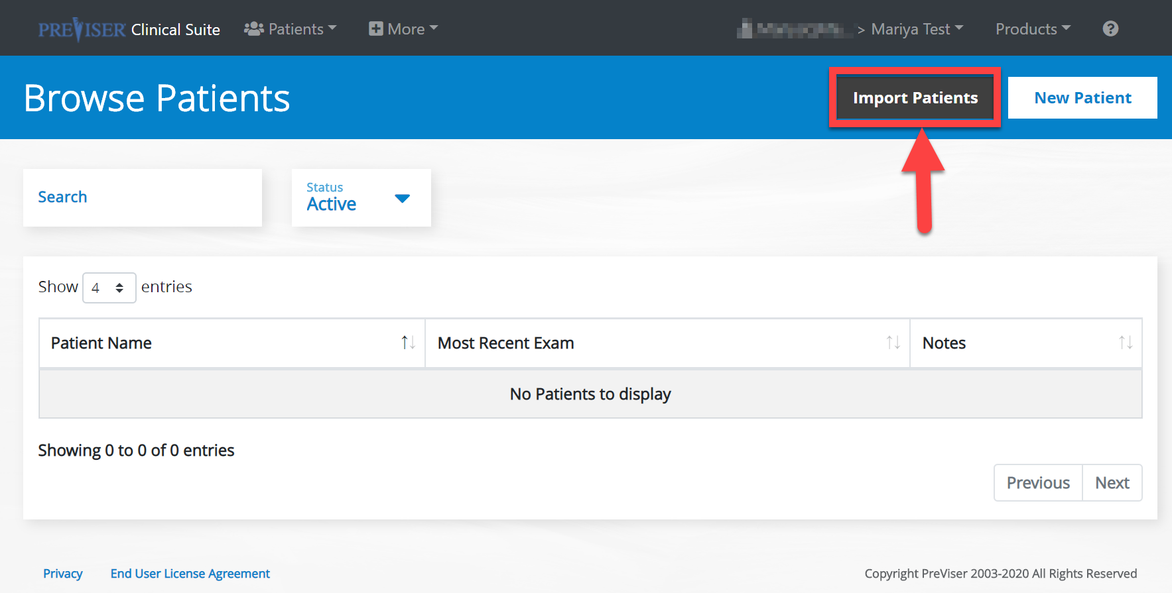
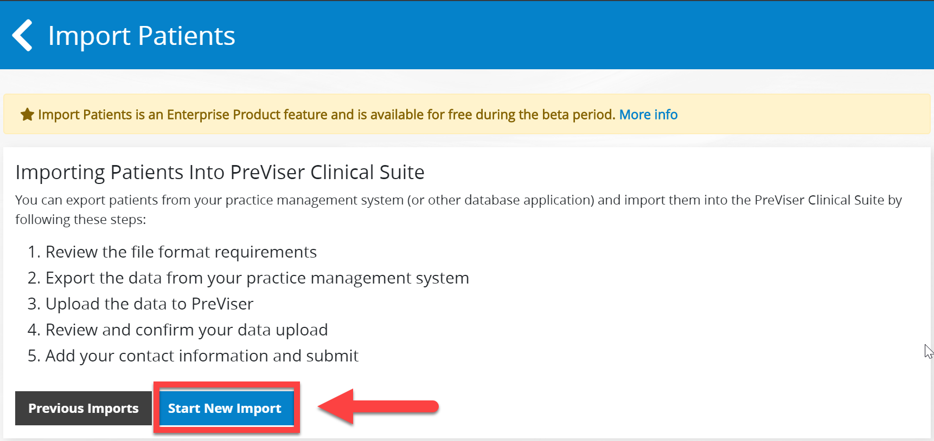
Providers can upload patient files into PreViser from the practice management software.
To upload patients, select the Import Patients button on the Browse Patients page:
The Import Patients page displays. Select the Start New Import button:

Slide 4
Read over the following guidelines and select Next:

Slide 5
You will be taken to the following page, again, read carefully and select Next:

Slide 6
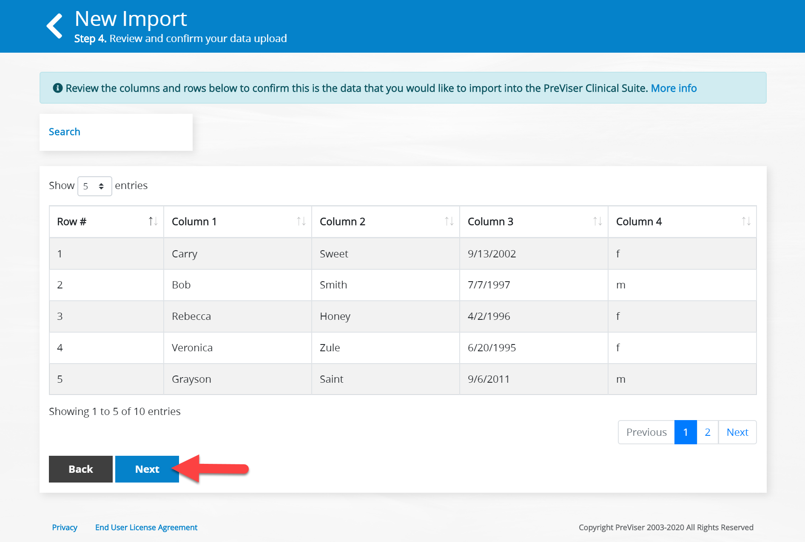
Be sure everything looks correct and select Next.
You then have to browse your computer and upload the patients file and select Next.

Slide 7
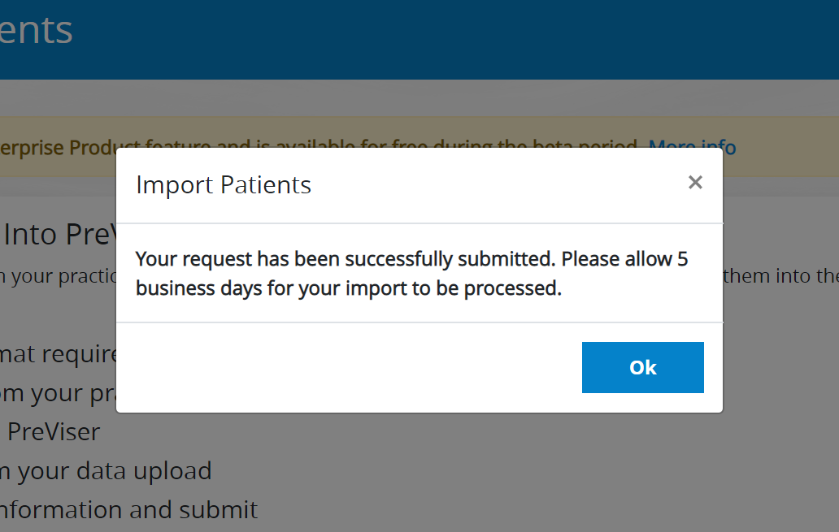
Fill out the following required information and select Submit:
You will see the following notification:

Slide 8
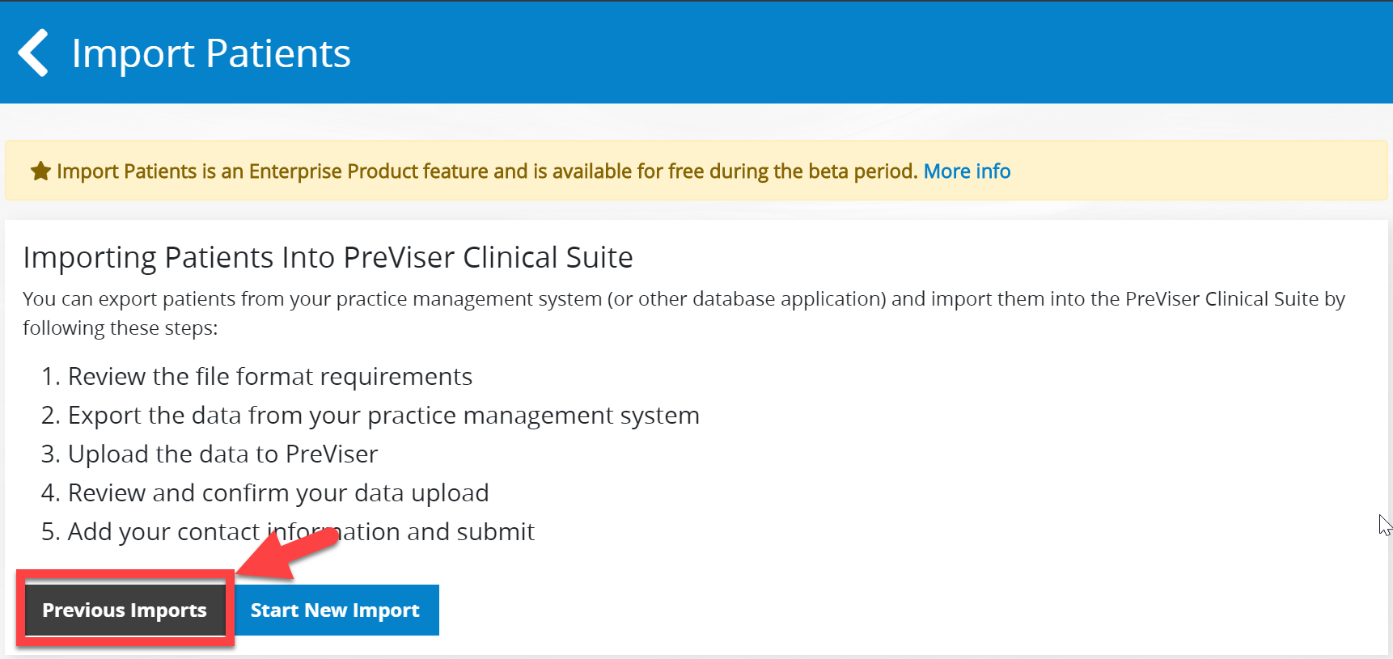
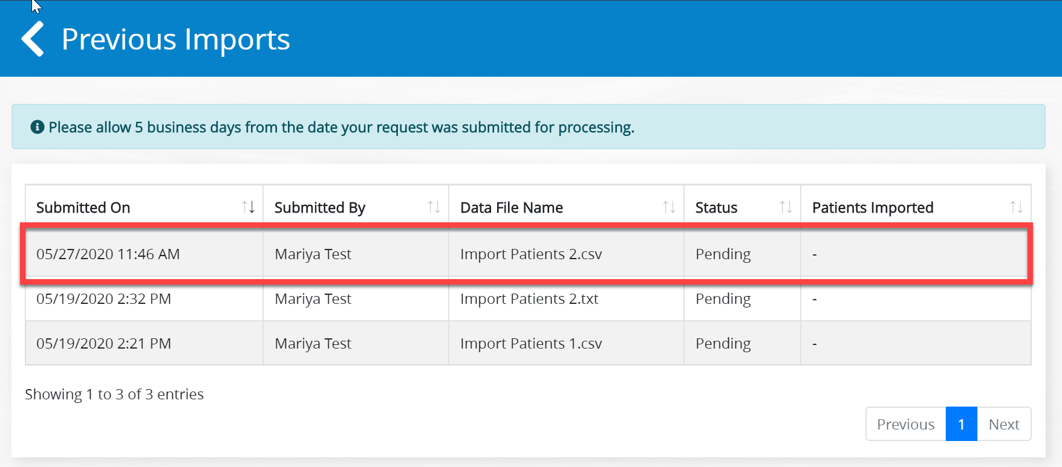
You should now be able to see your import in the Previous Imports section.

Slide 9
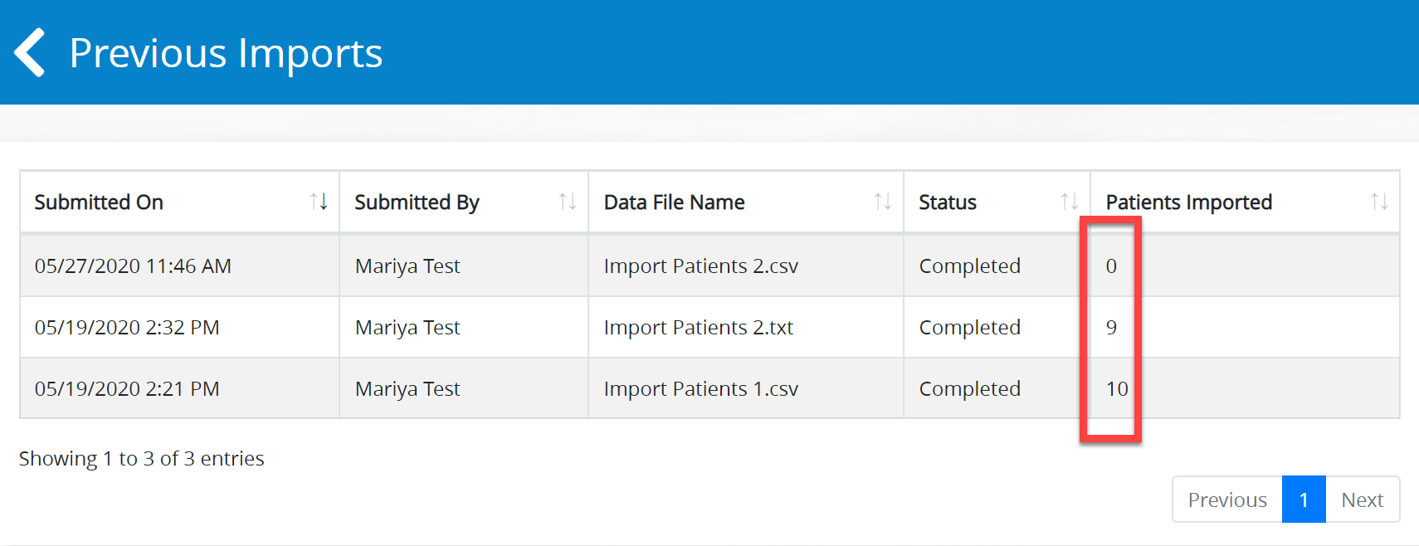
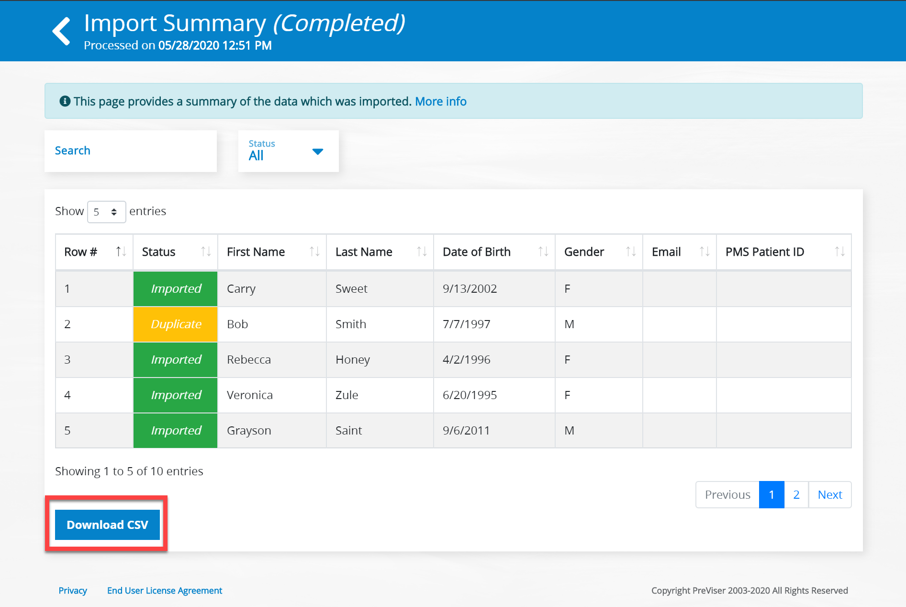
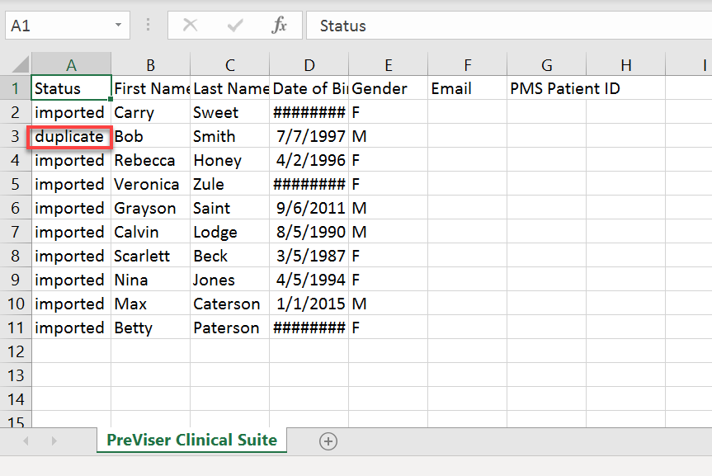
Once PreViser reviews your imports, you will have all the patient names that were successfully imported on the main Browse Patients page and you will also see the following Completed Status with the number of patients successfully imported:
Click on any of the imports and you will be taken to the import summary:
If there are any issues with the import, such as a duplicate, you can download the file and edit it before reuploading it once again.

Slide 10
Health Questionnaires

Slide 11
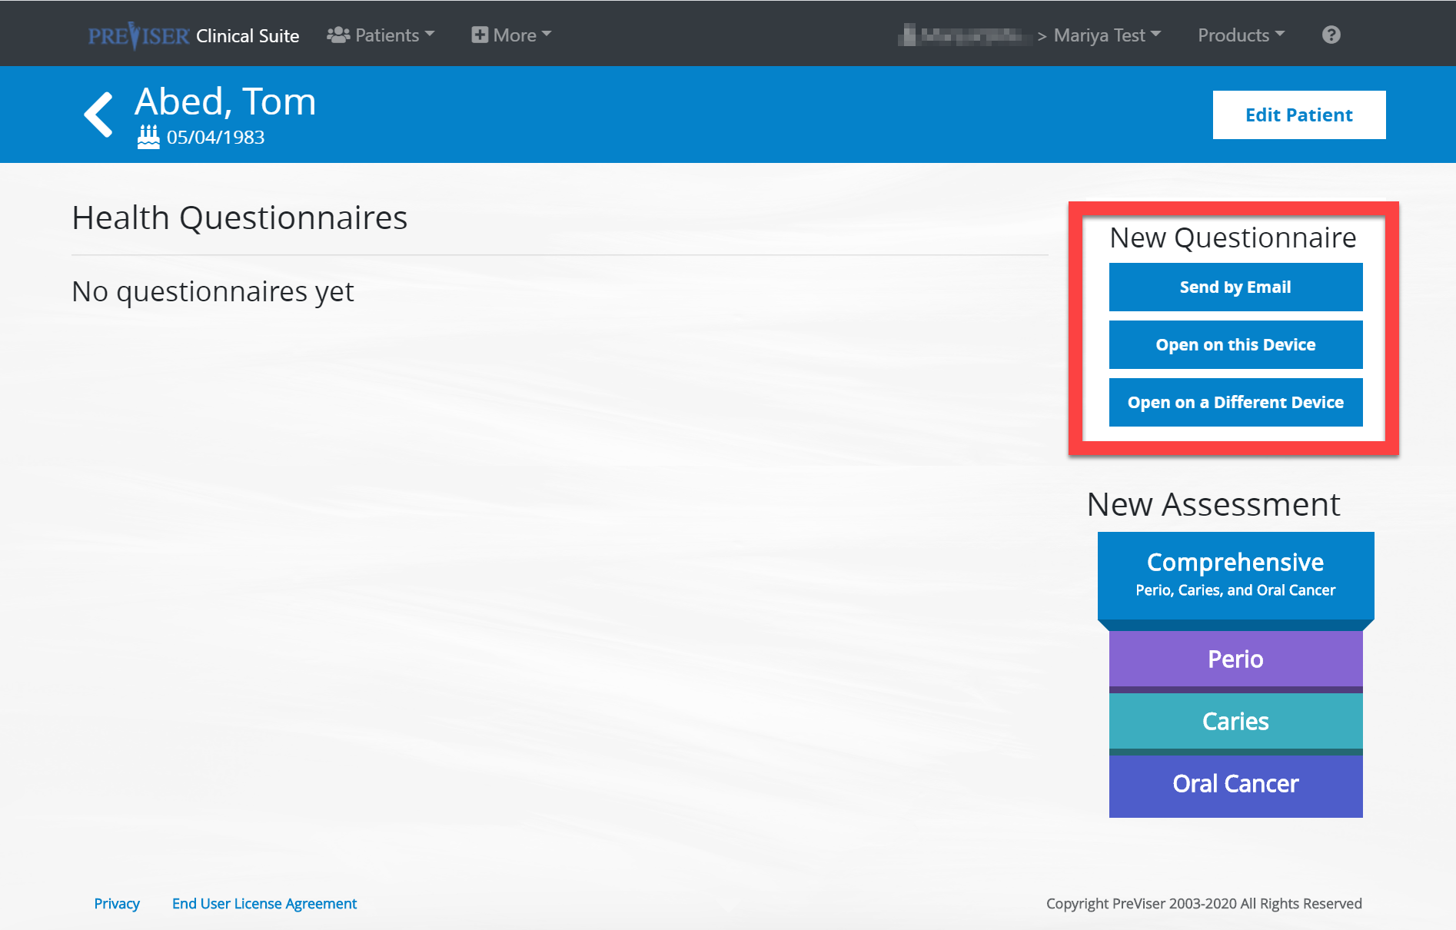
The health questionnaire contains assessment questions the patients can fill out themselves before being assessed by the clinician. The main purpose is to save time on clinician input and allow patients to be more hands on with their own oral health.
Select a patient from the patient list and click Health Questionnaires.

Slide 12
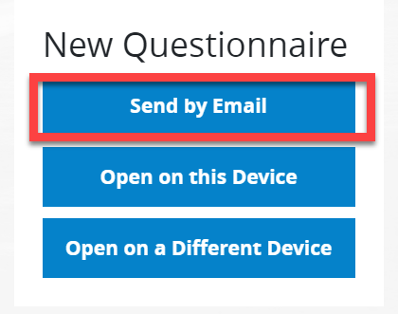
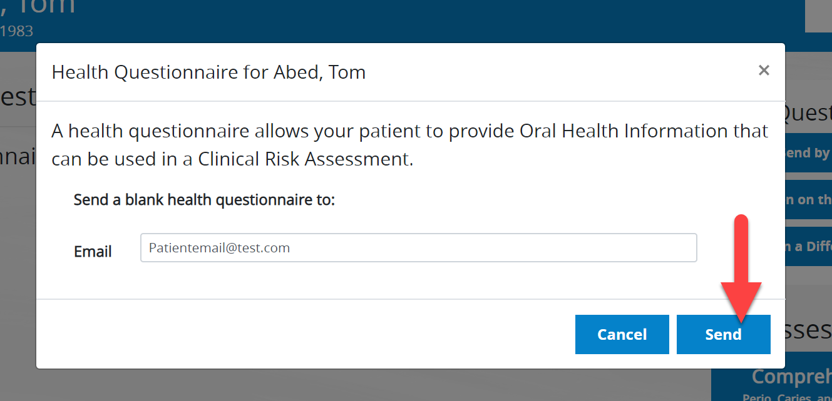
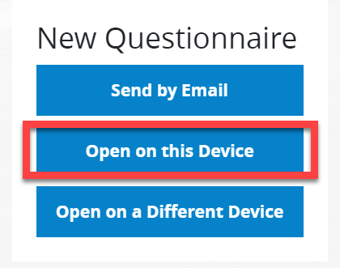
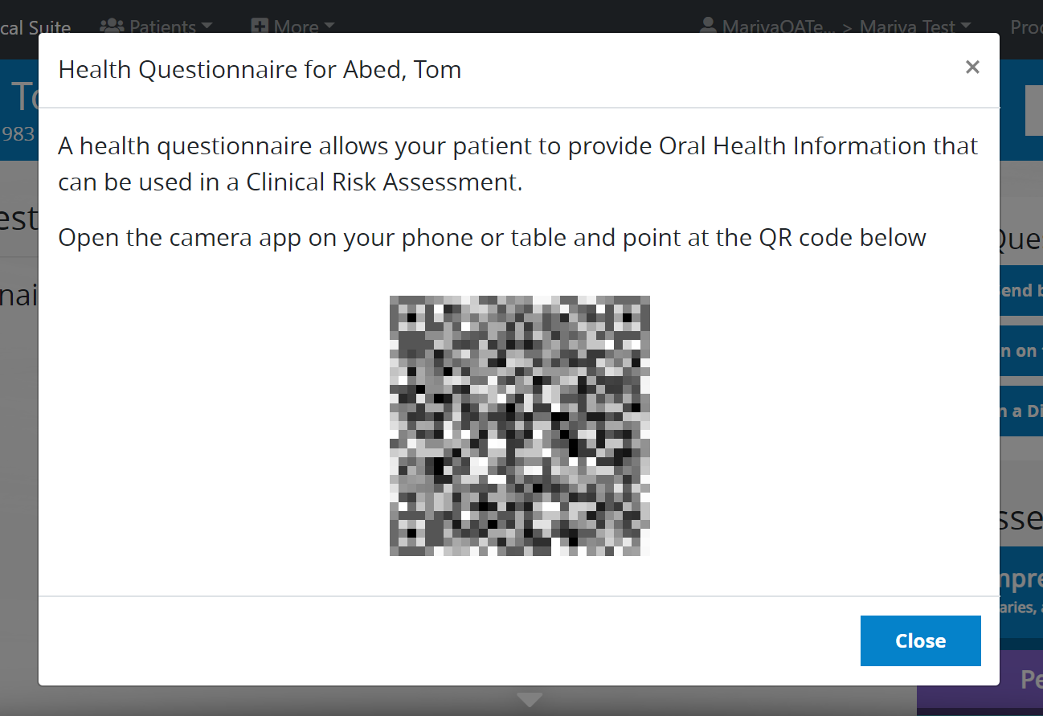
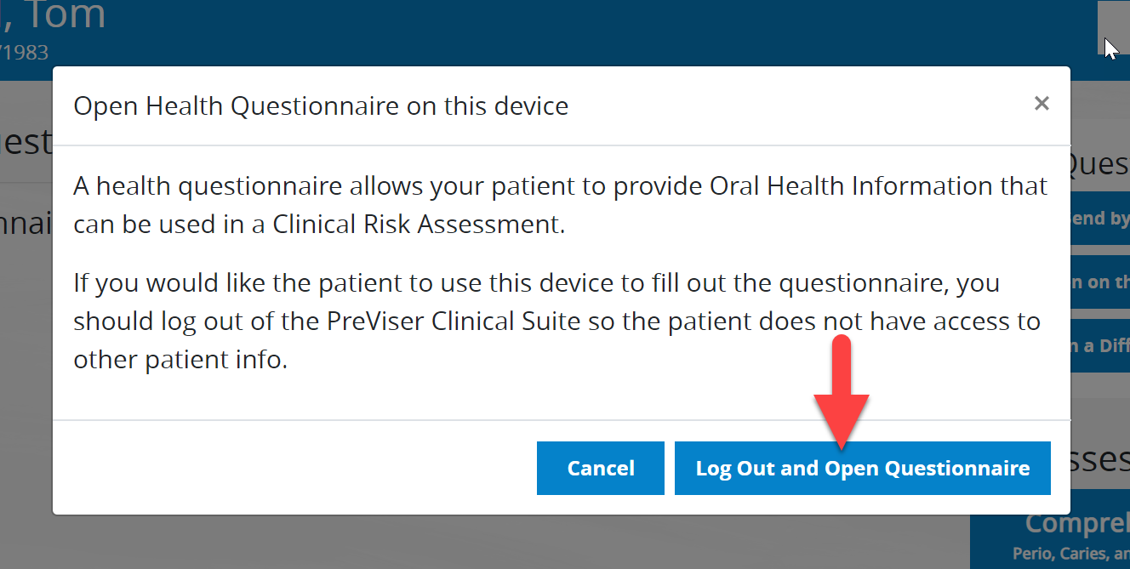
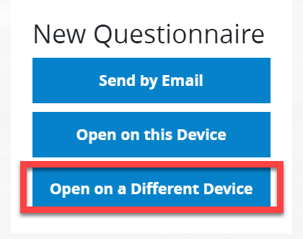
There are three options: Send by Email, Open on this Device, or Open on a Different Device.

Slide 13
Marketing Your Practice with Customization of Reports

Slide 14
Market Your Practice with Custom Reports
The customization function is a great way to market your practice.
Customization allows you to add information to all patient reports including:
Your practice website
To have your patient make an appointment
To educate your patient with oral health literature
Personalization of reports
Recommendations of specific oral care products your organization for specific risk and disease severity scores
Reminders to have patient make subsequent appointments

Slide 15
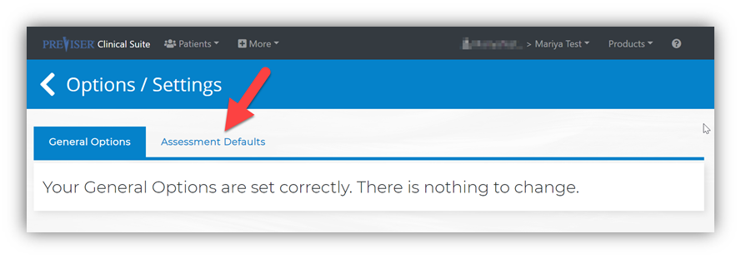
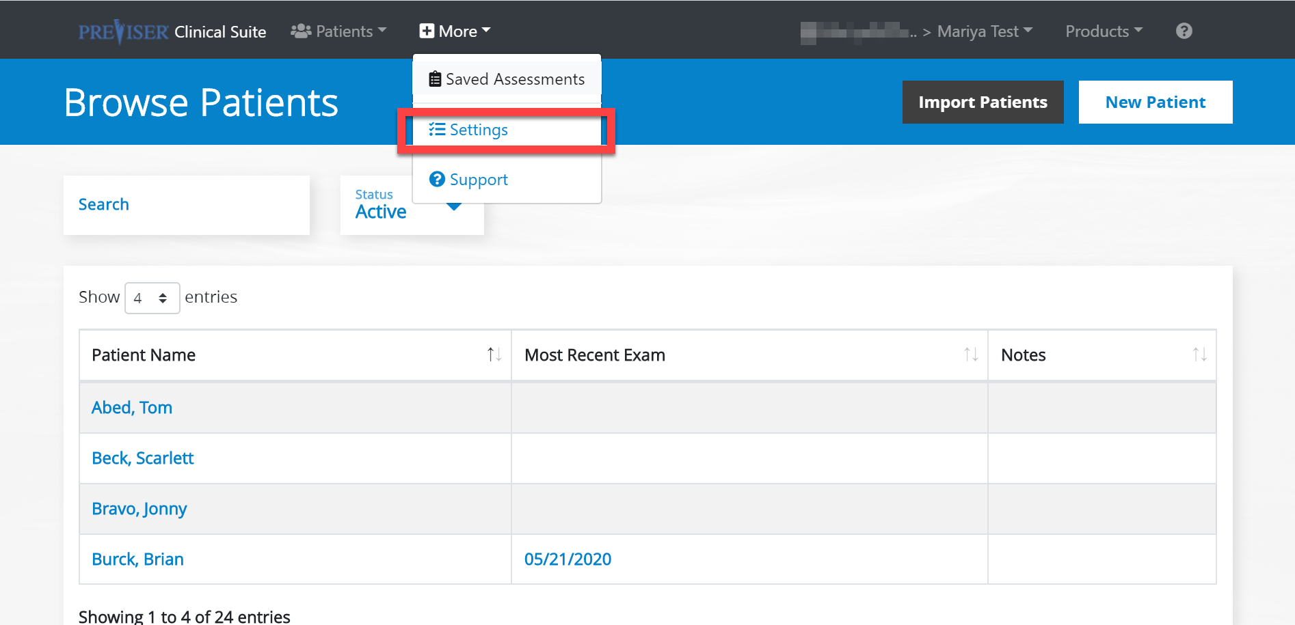
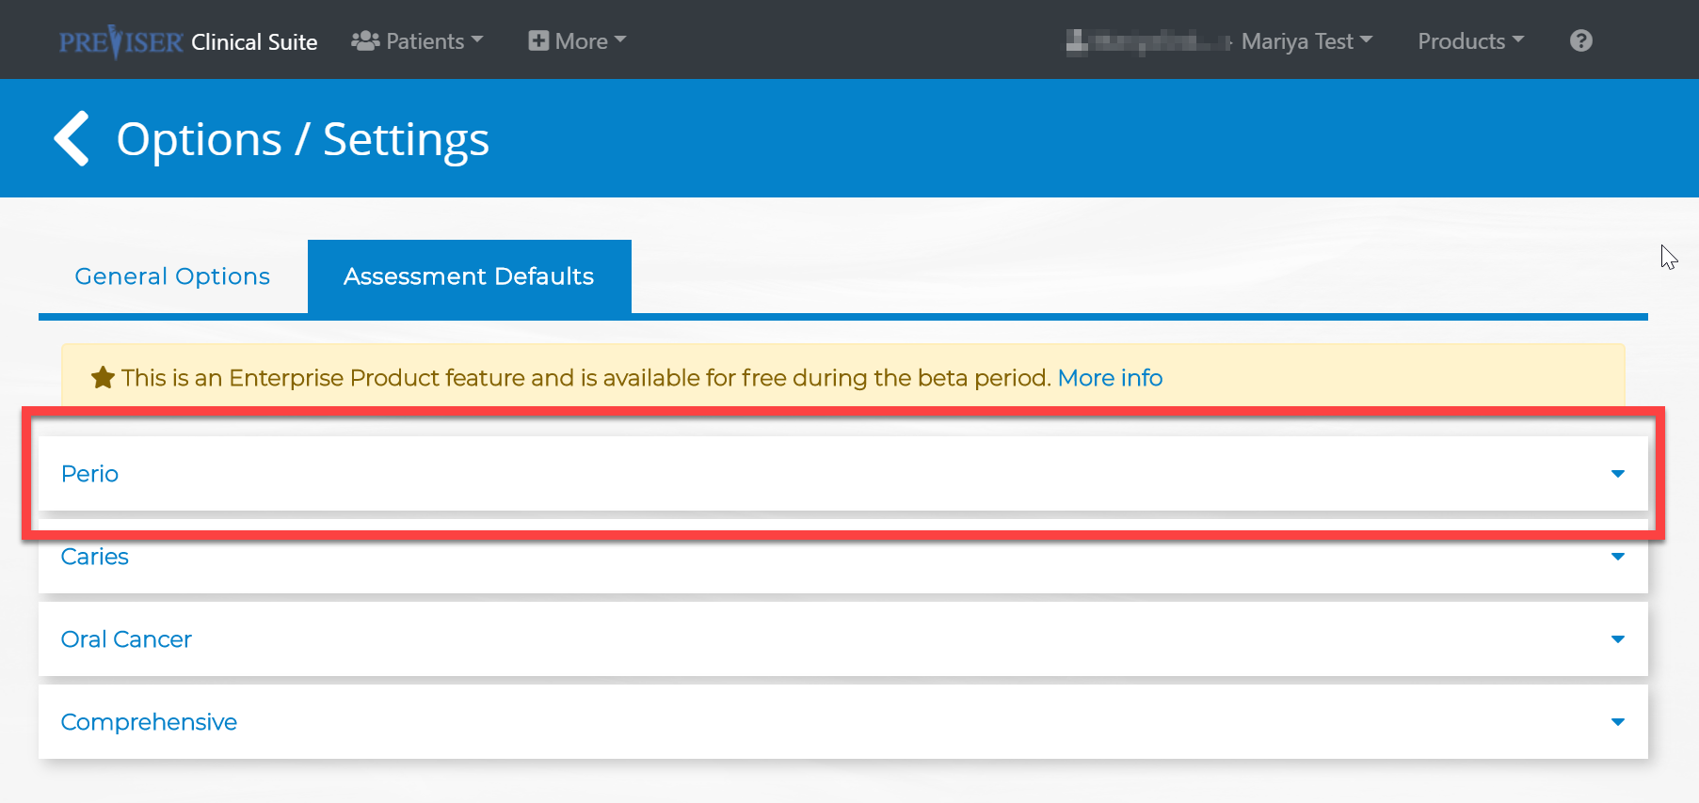
Customizing Reports – Admins
Account admins have the capabilities to customize the assessment defaults for the whole organization.
Once changes have been made, everything is automatically saved and you may go back to the main Browse Patients page. These changes become effective immediately for all users in the practice.

Slide 16
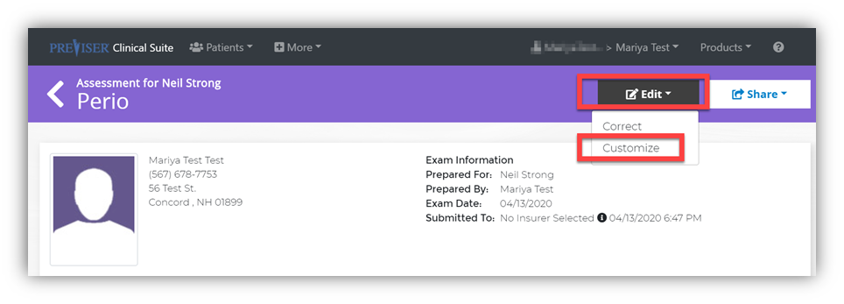
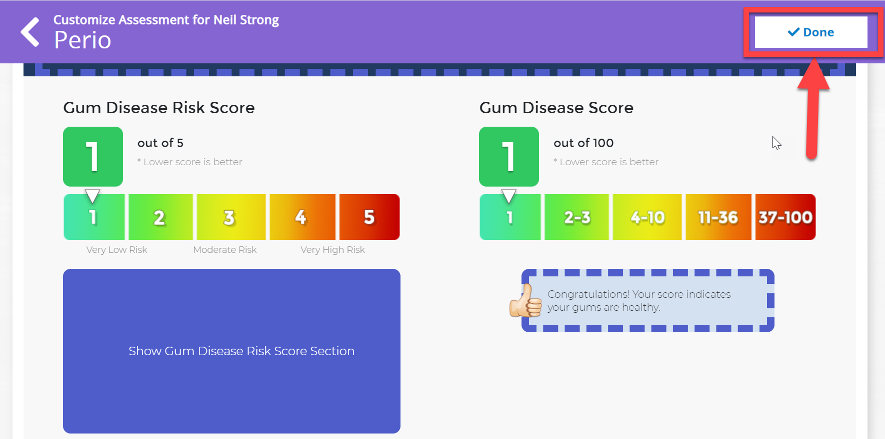
Customizing Reports – Other Clinicians/Users
Regular account users have the capabilities to customize individual patient reports.
Just be sure to select Done after the necessary changes have been made.

Slide 17
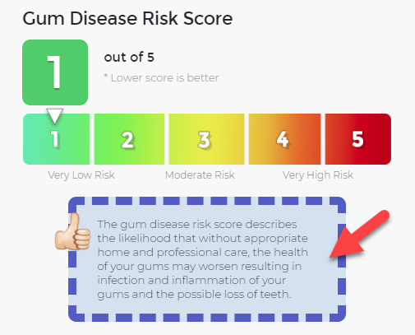
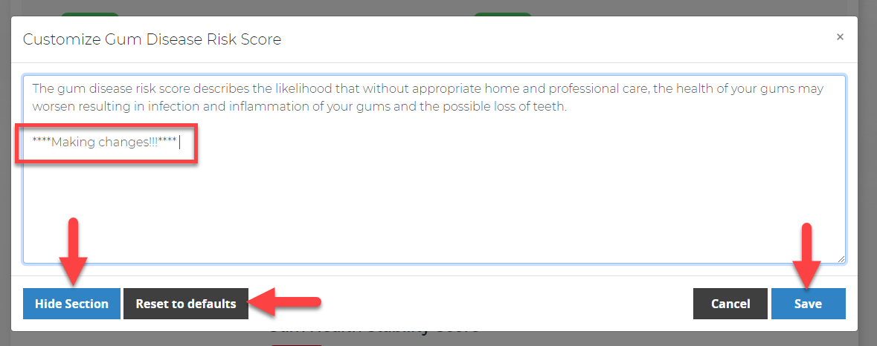
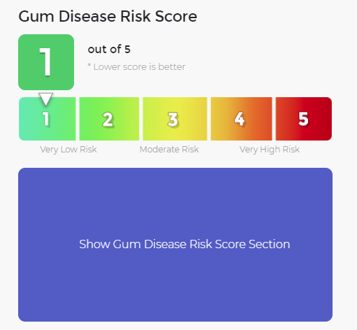
To make customizations, click anywhere inside the purple dotted area. Being making the desired changes.
Hidden section:
If you are not satisfied with the changes made, reset to the defaults.

Slide 18
Clinicians Practicing in Multiple Practices

Slide 19
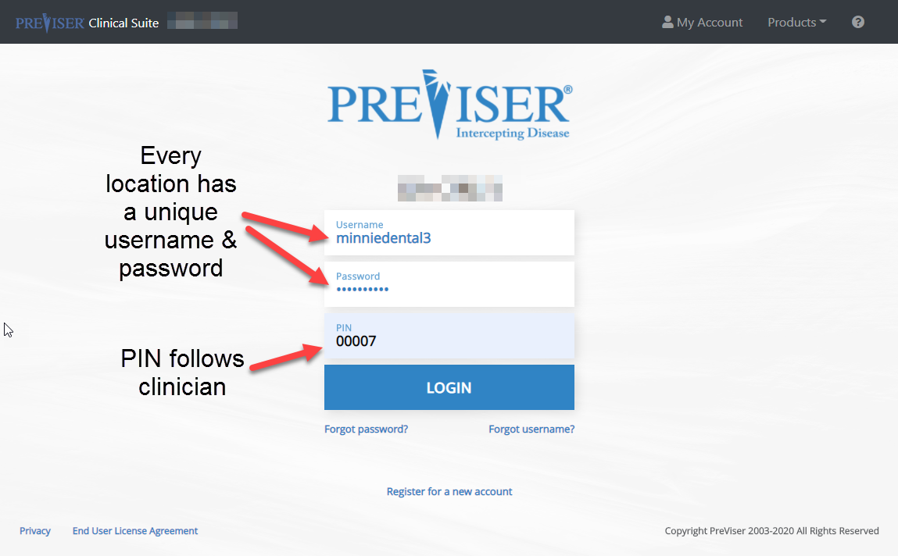
If an organization has multiple locations, clinicians are able to travel between the locations. Every location has a unique username and password and every clinician has a unique PIN. When a user is logging in, that user will use that particular location’s credentials, but will continue to use their own individual PIN.

Slide 20
Below the clinician Sue Totel is logged in to the location called minniedental3.
That same clinical Sue Totel is now logged in to the location called minniedental2.

Slide 21
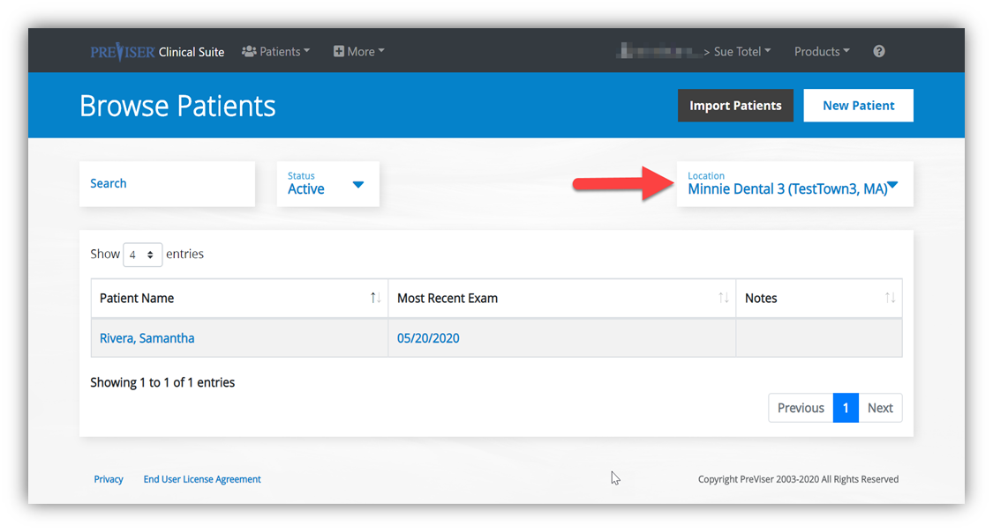
Why Do Clinicians Switch Between Locations?
This allows clinicians to import patient demographic information from another location within your organization. When logged in, a dropdown bar below the location name contains all the different locations under the group practice. Click on one and it will display all the patients who are under that location. Click on a patient from this new location and perform an assessment. That new patient record and assessment will now also be associated with the location where you have logged in.

Slide 22
PreViser Analytics

Slide 23
With PreViser Analytics, practice and DSO admins can track what clinicians are filling out assessments, what kind of assessments, and how often. The assessments are based on the ‘Prepared By’ clinicians, aka the individual PINs the employees use to sign in with.
The following shows you how to access PreViser analytics.

Slide 24
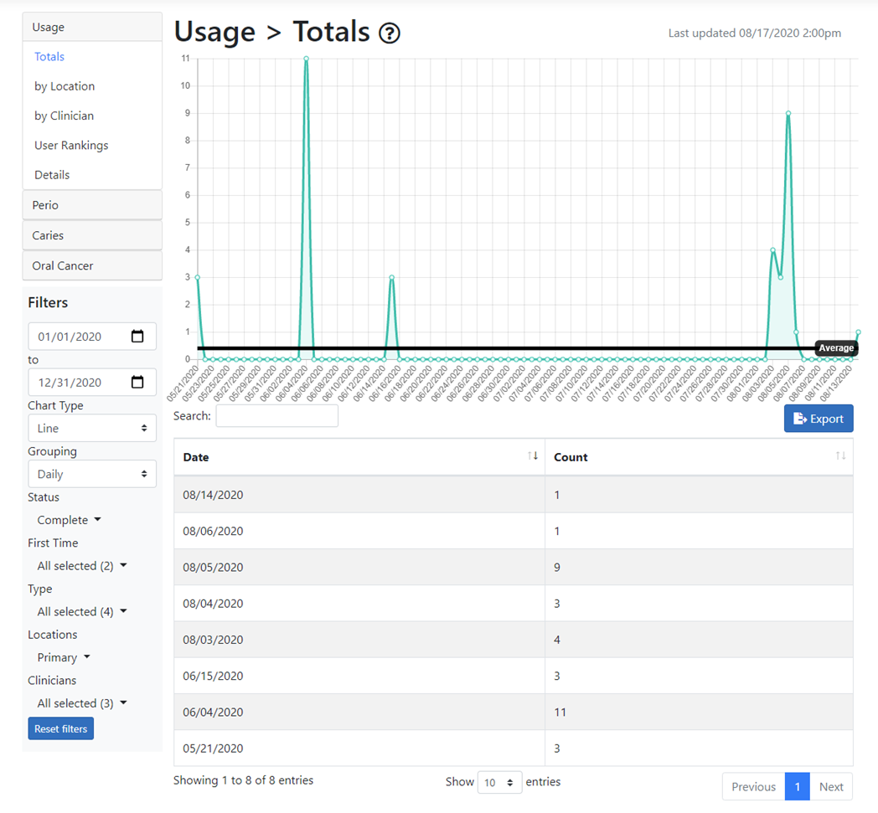
You will be taken to the following page:

Slide 25
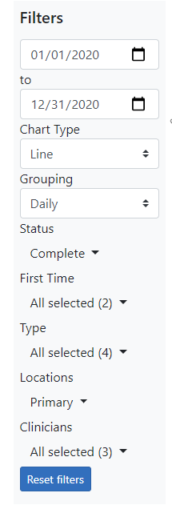
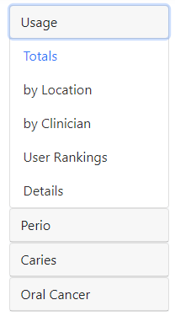
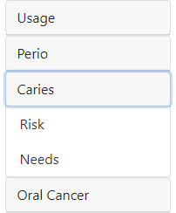
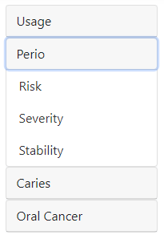
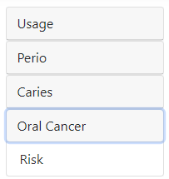
The admin can check the practice’s usage by the following categories.
The admin can also check out specific risk assessments.
The data can be filtered by date, frequency, statues of assessments, assessment type, location, clinician, and the type of chart the data is presented in.

Slide 26
Utilization Data with User Rankings
Usage data can be helpful with quality assurance and control within your dental office or across your DSO.
Understand which practice locations and/or clinicians are or are not performing assessments on patients on a regular basis
User rankings give snapshot information which can be used to pair top users with bottom users to facilitate getting the assessment into the workflow
“Details” provides specific data on all assessments completed by a user

Slide 27
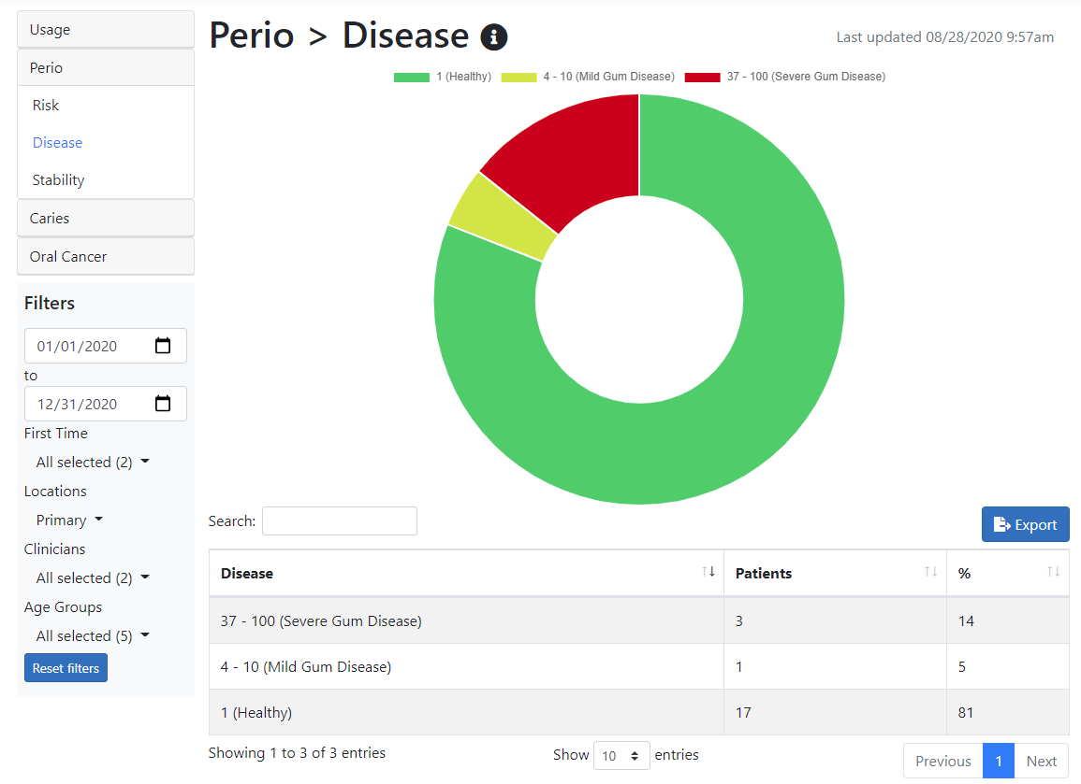
Risk and Disease Load Data
Risk and Disease Load data is also available and can be filtered by
Date
Location
Clinician
Age groups
Pairing this information with your claims data can help your practices start to identify gaps in care;
i.e., if 4 of John’s patients are high risk for caries, the provider may treatment plan 2 additional preventive cleanings and provide fluoride varnish

